Slide 1


Daniel Cordts
14/12/2025

Slide 2

Outline
Executive Summary
Introduction
Methodology
Results
Conclusion
Appendix

Slide 3
Executive Summary
Data Acquisition:
Data collection via an Application Programming Interface (API Calls).
Supplementary data gathering using Web Scraping techniques.
Data Preparation (Preprocessing):
Comprehensive Data Wrangling (cleaning, transformation, and structuring of raw data).
Data Analysis:
Exploratory Data Analysis (EDA) utilizing SQL queries.
Exploratory Data Analysis (EDA) through Data Visualization.
Visualization and Interaction:
Creation of interactive visual analytics using the Folium Python library.
Modeling:
Execution of Machine Learning prediction (Predictive Modeling).

Slide 4
Introduction
Project Context
SpaceX launches Falcon 9 rockets for $62 million, significantly less than competitors' $165 million cost. This advantage stems from reusing the first stage. Determining if the first stage will land successfully is key to calculating the true launch cost and is vital information for alternative companies bidding against SpaceX. The project's goal is to build a Machine Learning pipeline to predict the successful landing of the first stage.
Research Questions
The project seeks to answer:
Which factors determine a successful rocket landing?
How do various features interact to influence the landing success rate?
What operational conditions are necessary for a successful landing program?

Slide 5

Section 1

Slide 6
Methodology
Executive Summary
Data collection methodology:
Data was collected using SpaceX-API and web-scraping from Wikipedia.
Perform data wrangling
Perform exploratory data analysis (EDA) using visualization and SQL
Perform interactive visual analytics using Folium and Plotly Dash
Perform predictive analysis using classification models
How to build, tune, evaluate classification models

Slide 7
Data Collection
API Data Acquisition: Primary data collection was executed using GET requests directed to the SpaceX API.JSON Processing: API responses, decoded as JSON, were converted into a Pandas DataFrame using the .json_normalize() function call.
Data Wrangling: The data was subsequently cleaned, including the identification and imputation of any missing values.
Web Scraping: Supplemental launch records for Falcon 9 were scraped from Wikipedia utilizing BeautifulSoup.
DataFrame Conversion: The launch records, extracted as an HTML table, were parsed and converted into a Pandas DataFrame for subsequent analysis.

Slide 8
Data Collection – SpaceX API
A SpaceX API is used to request the data, then normalize it into a data frame and clean the data afterwards.
Link to notebook in Github:
https://github.com/ringedplover/coursera_ds/blob/main/capstone/jupyter-labs-spacex-data-collection-api-v2.ipynb
Get API Request
JSON - Normalization
Data Cleaning and Imputation

Slide 9
Data Collection - Scraping
First we web-scraped the html content via BeautifulSoup
Data processing into a pandas dataframe
Link to notebook in Github:
https://github.com/ringedplover/coursera_ds/blob/main/capstone/jupyter-labs-webscraping.ipynb
HTTP Get Request
Parse html with Beautifulsoup
Get Headers from data
Create Pandas Dataframe
Export to csv
9

Slide 10
Data Wrangling
Exploratory Data Analysis (EDA) Summary
We conducted the Exploratory Data Analysis (EDA) and subsequently defined the training labels for the predictive model.
We calculated the total number of launches at each launch site and determined the count and frequency of occurrence for each distinct orbit.
A landing outcome label (our target variable) was derived from the existing outcome column, and the processed results were then exported to a CSV file for further use.
Link to notebook in Github:
https://github.com/ringedplover/coursera_ds/blob/main/capstone/labs-jupyter-spacex-Data%20wrangling-v2.ipynb

Slide 11
EDA with Data Visualization
The data was visually explored to uncover relationships and trends.
Specifically, the following key relationships were plotted:
The relationship between Flight Number and Launch Site.
The relationship between Payload Mass and Launch Site.
The Success Rate of each Orbit Type.
The relationship between Flight Number and Orbit Type.
The Launch Success Yearly Trend.
Different techniques like bar, line-charts are used. On top of that different mapping-moduls.
Link to notebook in Github:
https://github.com/ringedplover/coursera_ds/blob/main/capstone/jupyter-labs-eda-dataviz-v2.ipynb

Slide 12
EDA with SQL
The SpaceX dataset was efficiently loaded into a SQL database directly from the Jupyter Notebook environment. Exploratory Data Analysis (EDA) was performed using SQL queries to gain immediate insights from the structured data.
Key SQL Queries Performed:
Identifying all unique launch sites utilized in the space missions.
Calculating the total payload mass carried by boosters launched for NASA (CRS) missions.
Determining the average payload mass carried by the F9 v1.1 booster version.
Finding the total count of successful and failed mission outcomes.
Identifying instances of failed drone ship landings, along with their associated booster versions and launch site names.
Link to notebook in Github:
https://github.com/ringedplover/coursera_ds/blob/main/capstone/jupyter-labs-eda-sql-coursera_sqllite.ipynb

Slide 13
Build an Interactive Map with Folium
All launch sites were marked on a Folium map, using markers, circles, and lines to visually represent the success (Class 1) or failure (Class 0) of each launch.
Launch outcomes were assigned as binary classes: 0 for failure and 1 for success.
Color-labeled marker clusters were used to visually identify which launch sites demonstrated a relatively high success rate.
Distances were calculated between each launch site and its surrounding proximities to answer questions such as:
Are the launch sites located near railways, highways, and coastlines?
Do launch sites maintain a minimum distance from cities?
Link to notebook in Github:
https://github.com/ringedplover/coursera_ds/blob/main/capstone/lab-jupyter-launch-site-location-v2.ipynb

Slide 14
Build a Dashboard with Plotly Dash
An interactive dashboard was built using Plotly Dash.
Pie charts were created to illustrate the total number of launches originating from specific sites.
Scatter graphs were generated to show the relationship between Launch Outcome (Success/Failure) and Payload Mass (Kg) across different booster versions.
Link to notebook in Github:
https://github.com/ringedplover/coursera_ds/blob/main/capstone/lab-jupyter-launch-site-location-v2.ipynb

Slide 15
Predictive Analysis (Classification)
The data was loaded using NumPy and Pandas, transformed, and split into training and testing sets.
Multiple machine learning models were built, and their hyperparameters were tuned using GridSearchCV.
Accuracy was used as the primary evaluation metric, and the models were further improved through feature engineering and algorithm tuning.
The project successfully identified the best performing classification model for the prediction task.
Link to notebook in Github:
https://github.com/ringedplover/coursera_ds/blob/main/SpaceX_Machine_Learning_Prediction_Part_5.jupyterlite.ipynb

Slide 16
Results
Exploratory data analysis results
Interactive analytics demo in screenshots
Predictive analysis results

Slide 17

Section 2

Slide 18
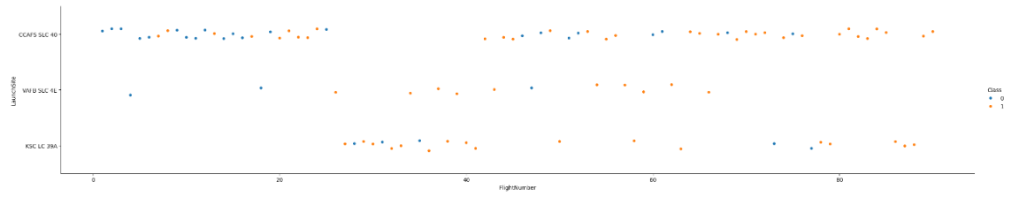
Flight Number vs. Launch Site
Early flights:
Success (blue) and failure (orange) were mixed, with many failures, particularly at CCAFS SLC-40.
Mid to late flightsThere is a clear increase in blue points (successes) across all sites, especially KSC LC-39A and CCAFS SLC-40.
This suggests the reliability and success rate improved over time.
KSC LC-39A appears to have maintained a high success rate from its first use.

Slide 19
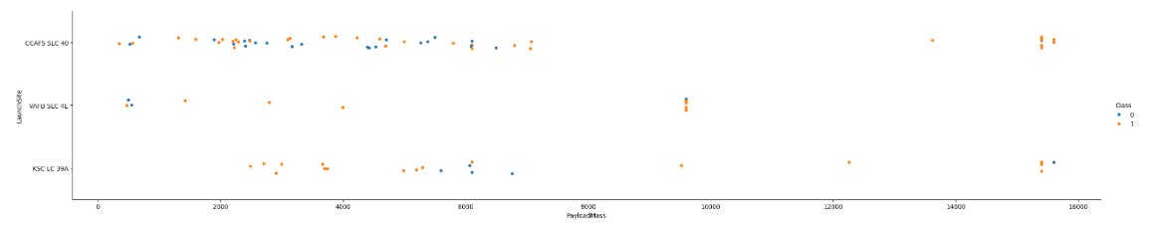
Payload vs. Launch Site
For the heaviest payloads, launches are almost exclusively blue (successful).
Failures (orange) are more common among the low to mid-range payload masses.

Slide 20
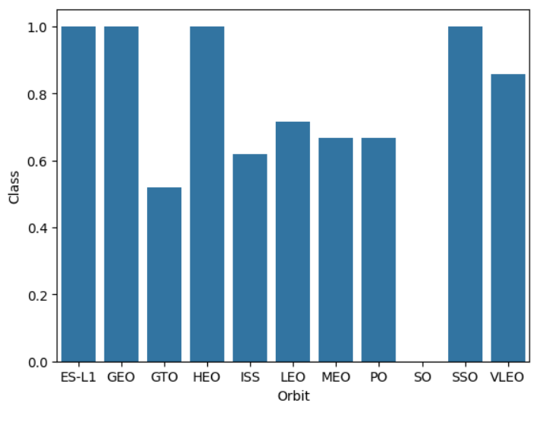
Success Rate vs. Orbit Type
Some Orbit-Types always succeed, others are less reliable.
SO never have been successful.

Slide 21
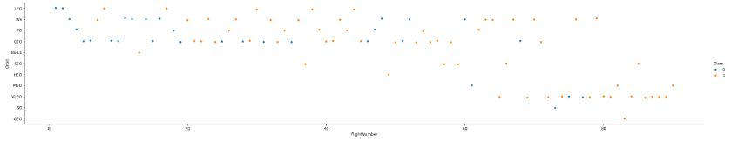
Flight Number vs. Orbit Type
Reliability Increases Over Time. The success rate (blue) of the rocket launches significantly increases with Flight Number (i.e., over time).

Slide 22
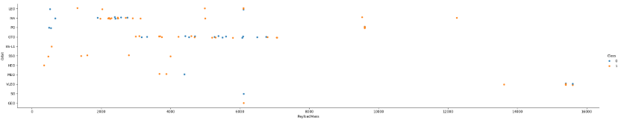
Payload vs. Orbit Type
Launches with the heaviest payloads are almost always successful at the respective launch sites (CCAFS SLC-40 and KSC LC-39A).
Failures are more common with light-to-medium payloads.

Slide 23
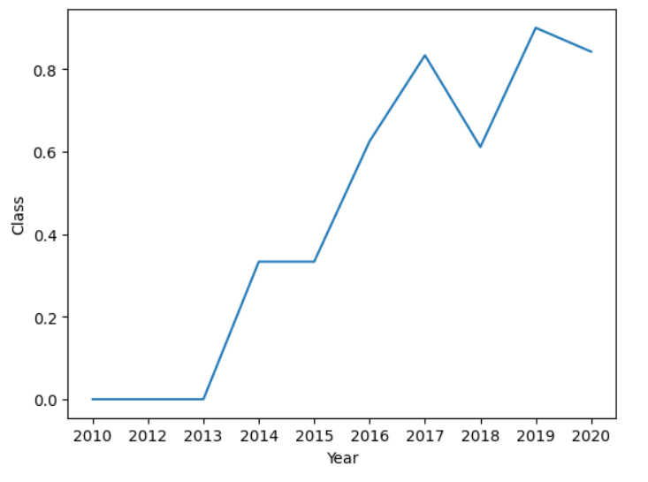
Launch Success Yearly Trend
The success rate has increased
over the recent years.

Slide 24
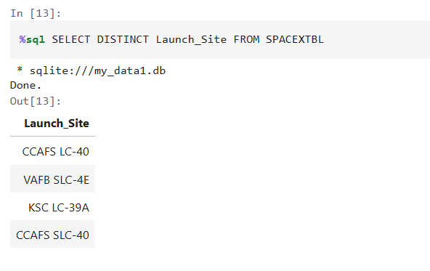
All Launch Site Names
There are four distinct launch site names.

Slide 25
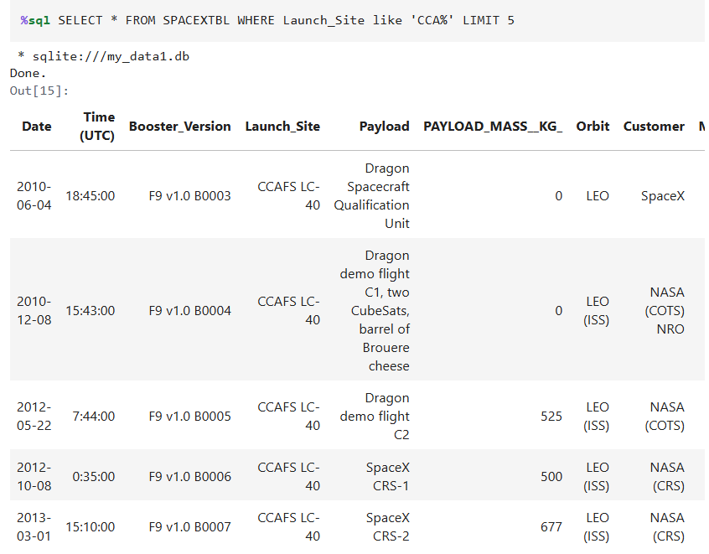
Launch Site Names Begin with 'CCA'
There are multiple distinct launch site names beginning with CCA.

Slide 26
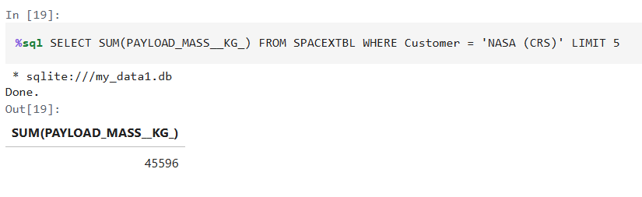
Total Payload Mass
The sum of the total payload mass is about 45,6 t.

Slide 27
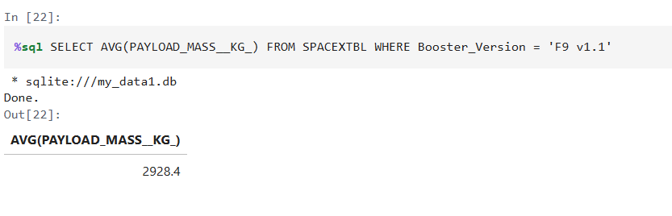
Average Payload Mass by F9 v1.1
The average payload for booster version F9 v1.1 is about 2.9 t.

Slide 28
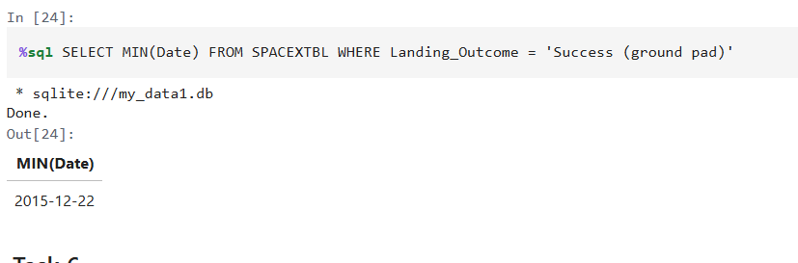
First Successful Ground Landing Date
The first successful landing was on the 22nd Dec of 2015.

Slide 29
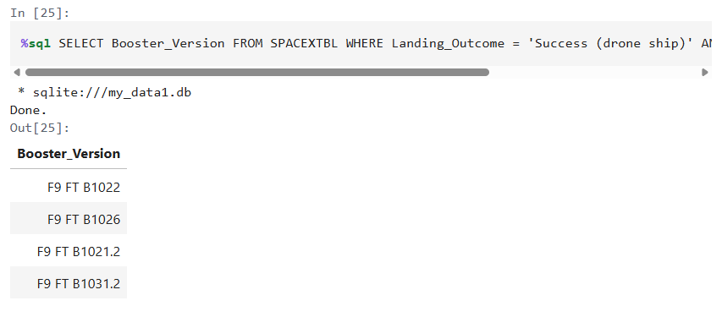
Successful Drone Ship Landing with Payload between 4000 and 6000
There are four different drone ship landings with payload between 4 and 6 tons.

Slide 30
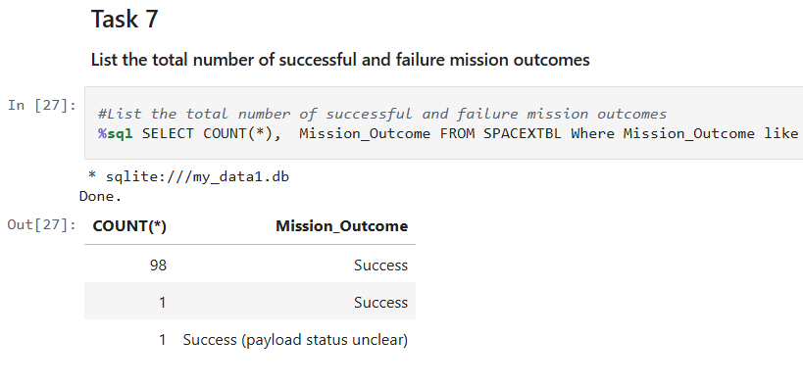
Total Number of Successful and Failure Mission Outcomes
There have been 100 successful outcomes and 1 failure.

Slide 31
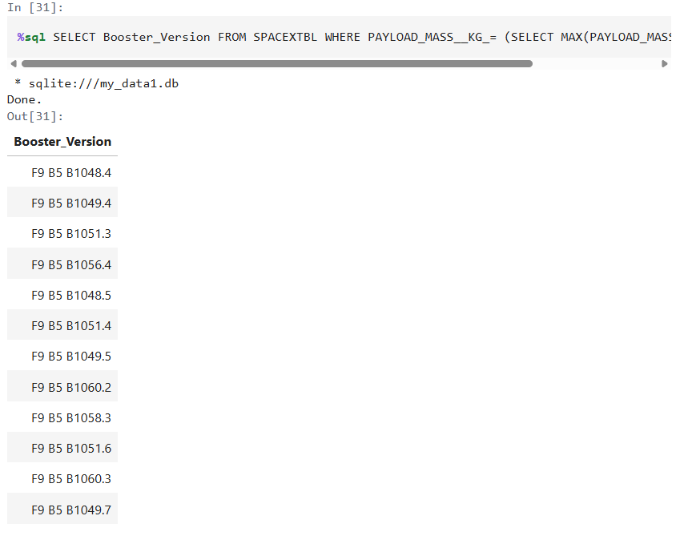
Boosters Carried Maximum Payload
There are multiplie booster version of type F9 B5 carrying maximum payload.

Slide 32
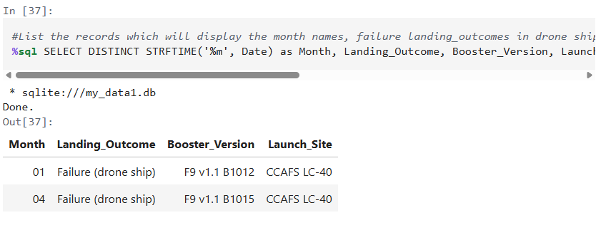
2015 Launch Records
There were 2 failed drone ship landing in 2015.

Slide 33
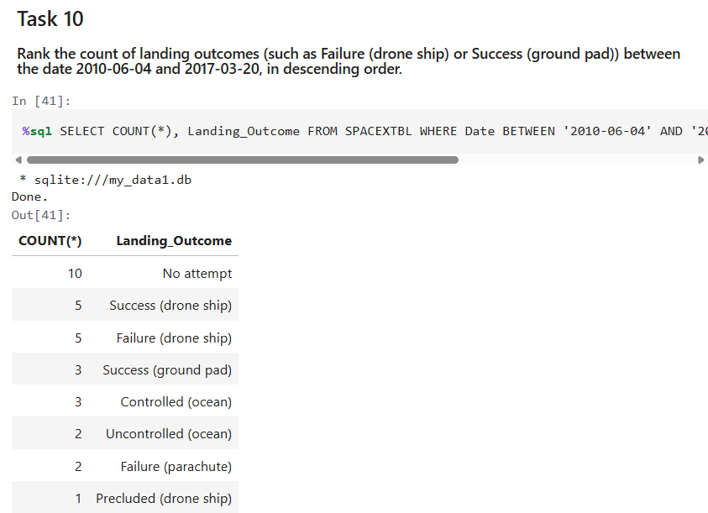
Rank Landing Outcomes Between 2010-06-04 and 2017-03-20
There have been multiple landing in those
Seven years. Most with no attempt.

Slide 34

Section 3

Slide 35
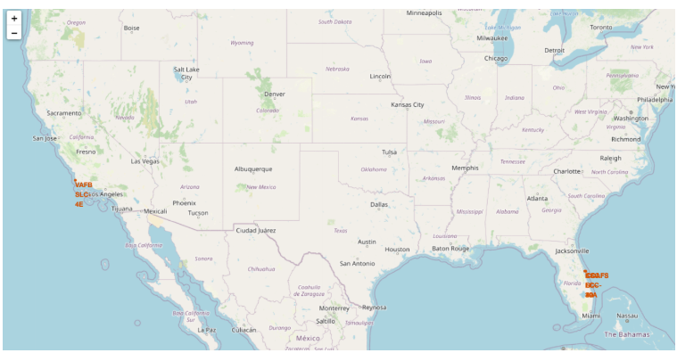
Overview Launch Sites
All locations are very close to coast, and a relatively close to the Equator line regarding the sites are in the US.
The proximity to the Equator ist most fuel-efficient as the Earth rotation helps to boost the rockets.
The coast proximity is more a safety factor. In case of failture the wreckage falls into the sea.

Slide 36
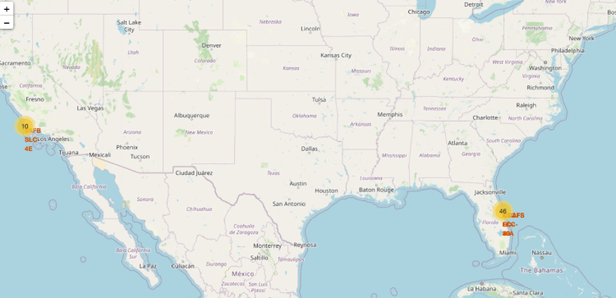
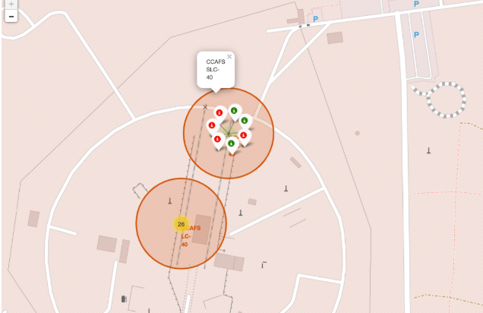
Overview success/failed launches for each site
There are more starts in the south east stations. In the detail overview you can see the red dots as failures and the green dots as succeeded starts.

Slide 37
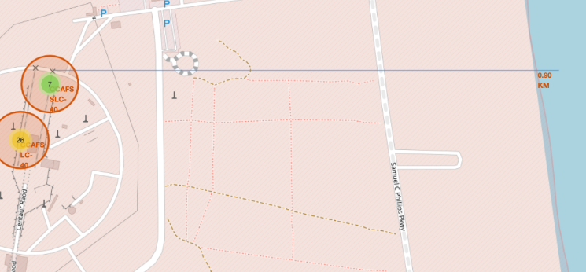
Example of proximity map
You can see that the proximity to the coast (about 900 m)
Furthermore there is no real town next to it.

Slide 38

Section 4

Slide 39
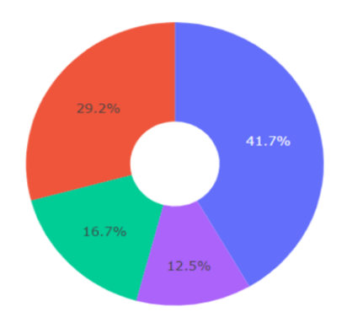
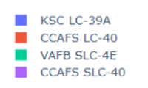
Success Rates for all Sites
The station KSC LC-39A has
the highest success rate.
The station KSC LC-39A has
the highest success rate.

Slide 40
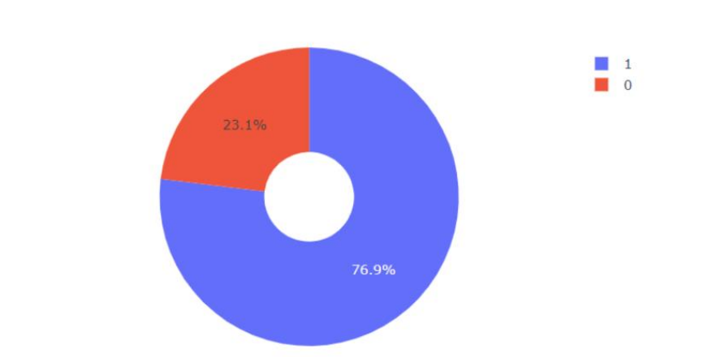
Failure/Success Rate on most successful site

Slide 41
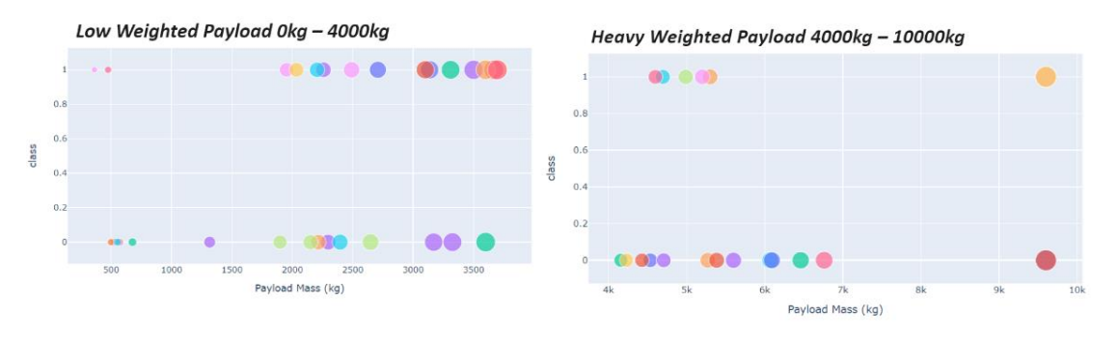
Distribution of Payload and Outcome for all sites
Low weighted payloads show a higher success rate.

Slide 42

Section 5

Slide 43
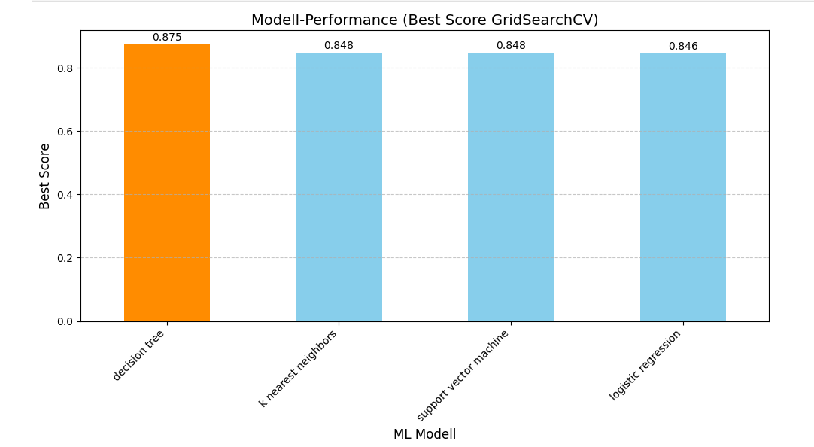
Classification Accuracy

Slide 44
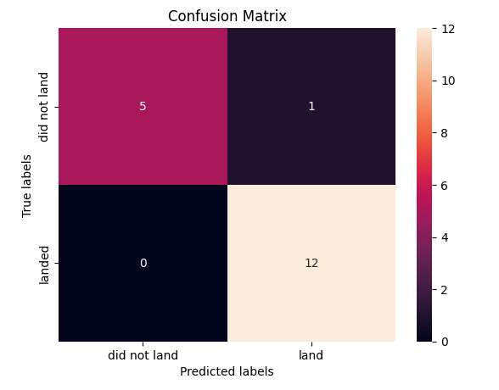
Confusion Matrix
Based on the test-data the modell is able to classify 17 cases correctly and only 1 case incorrectly.

Slide 45
Conclusions
Launch Site Success Correlation: A positive correlation exists between the total number of flights at a launch site and its resulting success rate.
Historical Trend: The overall launch success rate demonstrated a consistent increase over the period from 2013 to 2020.
The orbits ES-L1, GEO, HEO, SSO, and VLEO recorded the highest overall success rates.
KSC LC-39A achieved the highest number of successful launches compared to all other sites.
The Decision Tree Classifier was identified as the best machine learning algorithm for this classification task.

Slide 46


